Slide 1


Heya Plus Size
Business Model Canvas

Slide 2
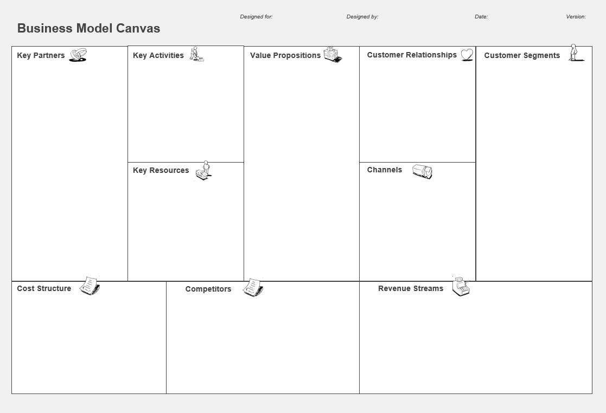
Designed for: Heya Plus Size Designed By: Sara Hussein Date: 15th October 2024
Key Partners
Key Activities
Value Proposition
Customer Relationships
Customer Segment
Subscription Services
Fashion Designers
Manufacturers
Suppliers
Shipping Companies
Influencers and bloggers
Retail Partners
Marketing team
E-commerce Platform
Graphic designer
Photographer
Social Media platforms
Reels maker
Website developer
Customer Service Providers
Social Media Management system
CRM System
Market Research
Design Sourcing
Quality Review
Content Creation
Influencer Collaboration
Website Updates
Customer Service
Order Management
Data Collection
Packaging
Shipping Coordination
Customer Follow-Up
Trend Analysis
Build a supportive community by engaging with customers through giveaways, responsive communication, and penetration pricing to build loyalty, Comfortability, and happiness.
Sales offer
PR campaign
Body positive, trendy clothing that promotes self love and confidence, with a perfect fit for all body types.
Women in Egypt, aged 25-45, single and married, middle to upper-middle class, well educated, seeking fashionable plus size clothing.
Key Resources
Channels
Raw Materials
Financial Resources
Suppliers
Inventory
Customer Service Team
Industry Experts
E-Commerce Website
Analytics Tools
Influencers
Fashion Designers
Distributors
Manufacturers
Shipping Companies
Retailers
Social Media Platforms
Marketing Resources
CRM System
Website
Facebook
Instagram
TikTok
Cost Structure
Raw Material Costs
Production Expenses
Marketing Expenses
E-commerce Platform Fees
Inventory Holding Costs
Customer Service Expenses
Influencer Collaboration Costs
Design and Development Costs
Operational Expenses
Rent
Taxes
Salaries
Internet
Licensing Fees
Shipping Costs
Sourcing
Software and Tools Costs
Competitors' Weaknesses
Limited Awareness Compared to Competitors
Restricted Sizes
Higher Prices
Limited Presence in the Egyptian Market
Shipping Delays
Revenue stream
Competitors' Strengths
Focus on High-Quality Fabrics
Local Expertise
High Funding
Personalized Styling
Established Brand Loyalty
Local Understanding of Consumer Needs
Direct sale
Online Promotions
Loyalty Programs
Event booths

Slide 3
SWOT Analysis

Slide 4
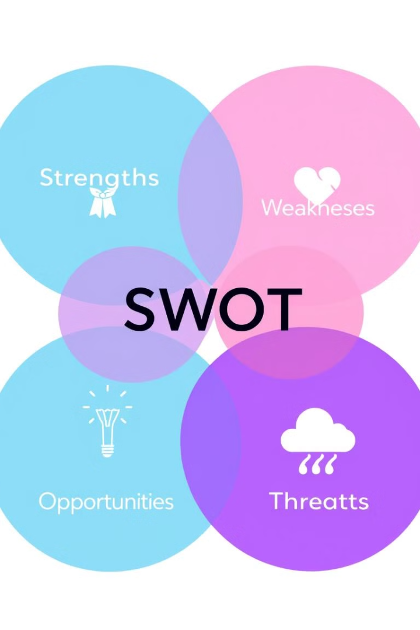
Strengths
Product Variety
Digital Marketing Expertise
Marketing Activities
Trend Diversification
High-Quality Products
Trendy Styles
Body Positivity Philosophy
Weaknesses
Limited Brand Recognition
Production Delays
Low-Profit Margins
Limited Financial Resources
Low Experience
Opportunities
Cultural Fit
Online Expansion
Changing Preferences
Growing Market
Minimal Competitors
Threats
Economic Uncertainty
Supply Chain Disruptions
Niche Market Risks
Currency Dependency
Potential New Entrants
Challenges with Distributors
Brand Loyalty of Competitors

Slide 5
SMART
Objectives

Slide 6
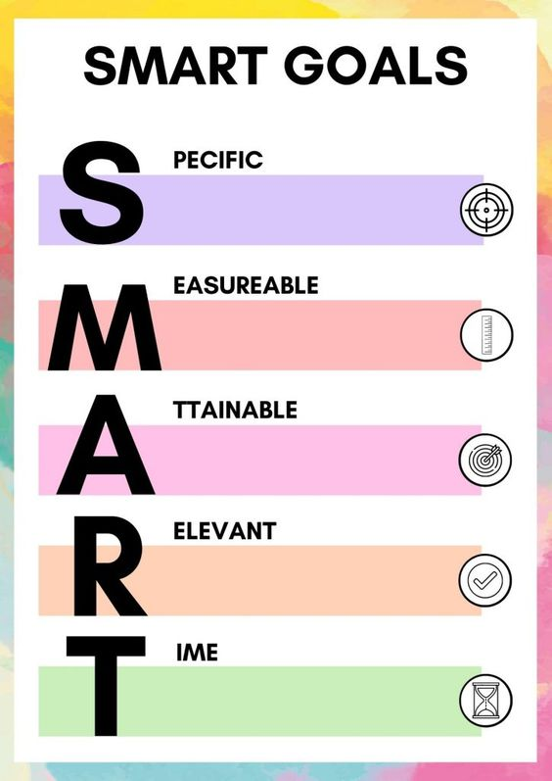
SMART Objectives
1
Brand Awareness
Increase brand awareness by 20% in plus-size market within the next six months.
2
Social media engagement:
Objective: Improve the engagement rate to 35% across social media platforms within three months.
3
1Website Traffic
Increase website traffic by 30% by the end of the 1st quarter.
4
Conversation Rate
Increase the conversion rate from to 10% by the end of the 2nd and 3rd quarter.

Slide 7
Target Market

Slide 8
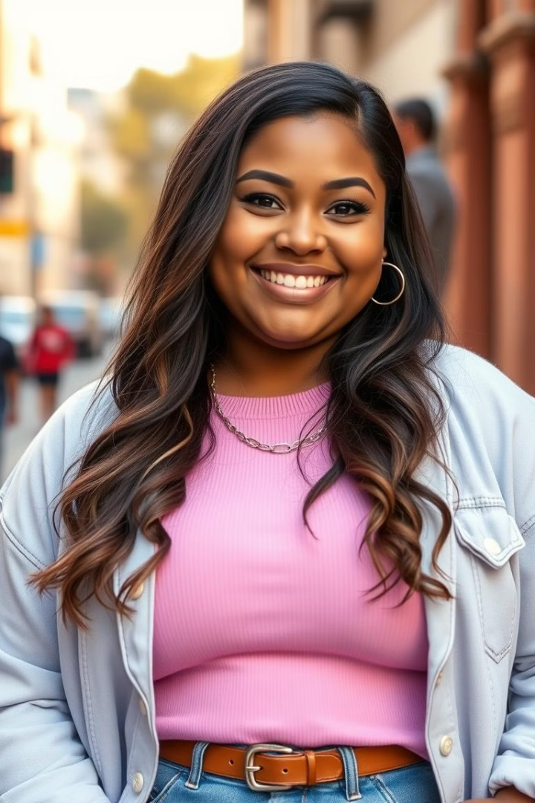
Persona 1: Yara
Demographics
Age: 28, Location: Alexandria, Occupation: HR Manager, Marital Status: Single, Weight: 95 kg, Education: Bachelor
Interests
Online shopping, social activities with friends
Needs
Trendy fashion and elegant fit to enhance confidence
Motivations
Real customer reviews, recommendations from trusted influencers, variety of styles and colors

Slide 9
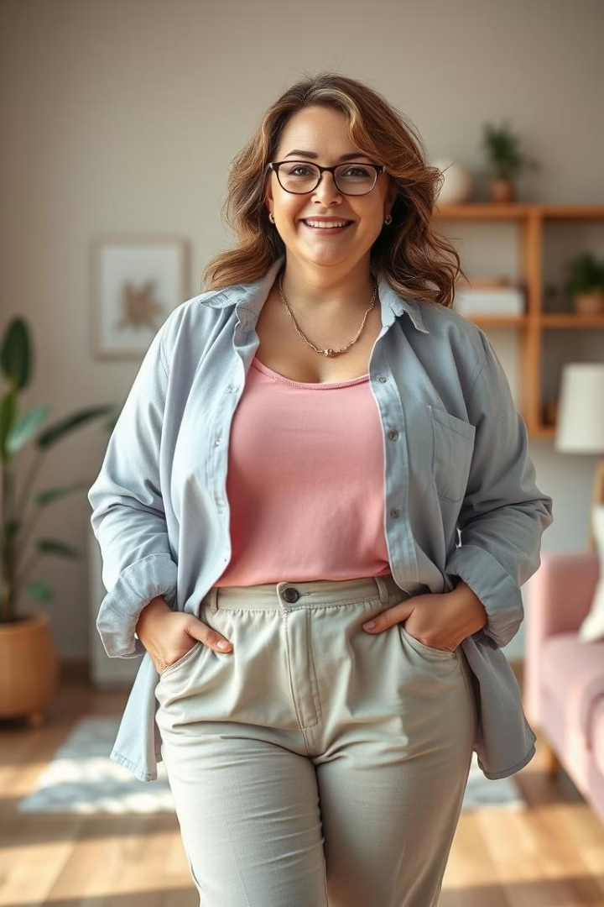
Persona 2: Nariman
Demographics
Age: 39, Location: Cairo, Occupation: Housewife, Marital Status: Married, Two Children, Weight: 120 kg, Education: Bachelor.
Interests
Clubs, family events, cooking.
Needs
Everyday clothes that are comfortable, practical, high quality, and suitable price.
Motivations to Buy
Offers, suitable price, recommendations and reviews from mom influencers.

Slide 10
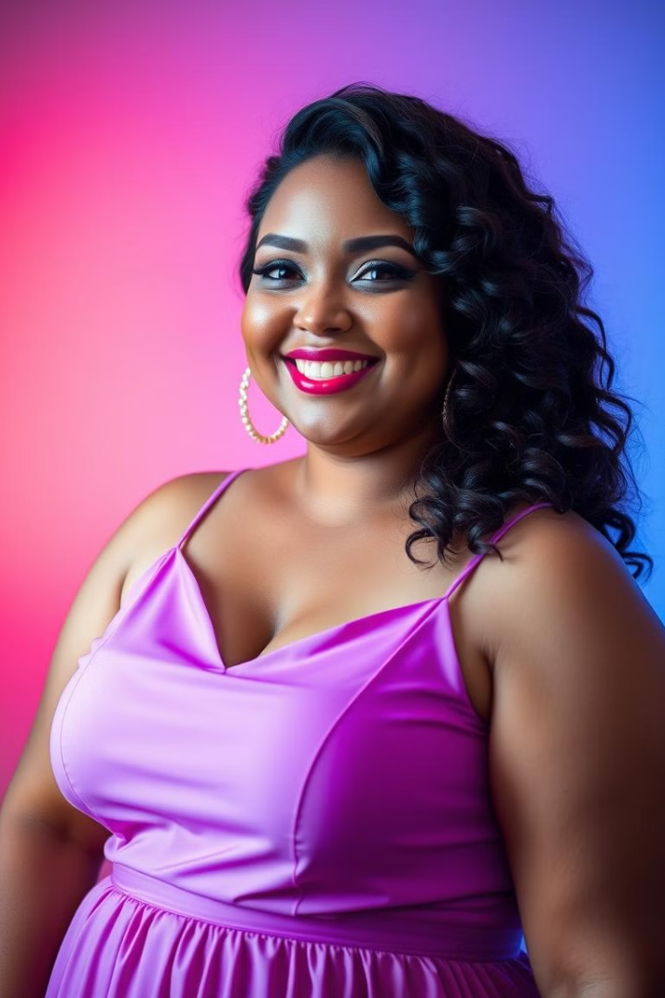
Our Value Proposition
Confidence-Boosting
Helping women feel confident by providing stylish, comfortable clothing that fits every body shape.
Trend-Focused
Offering a wide selection of fashionable designs that cater to current trends.
Inclusive Fit
Meticulously crafted clothing that enhances comfort and style for all body types.

Slide 11
Marketing Mix (4Ps)

Slide 12
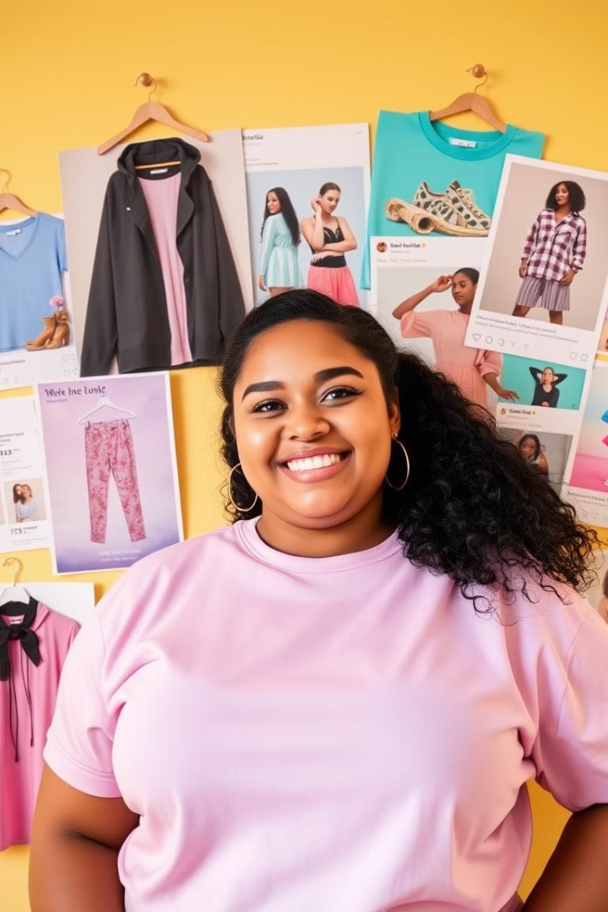
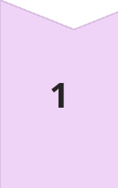
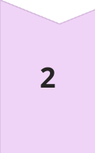
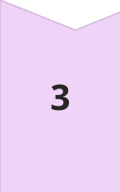
Product
Product: specifically designed for plus-size women.
Fabrics: High quality materials to ensure comfort.
Variety: A wide selection of styles and colors tailored to preferences and current trends.
Manufacturing: Meticulously crafted to enhance comfort and style
Price
Penetration Strategy
Class B and B+
Starting from 400 EGP to 2500 per item
Place
Online Retail: Website: Our e-commerce platform facilitates hassle free shopping.
Social Media Sales: Engaging with customers and highlighting products on Facebook and Instagram for direct shopping features

Slide 13
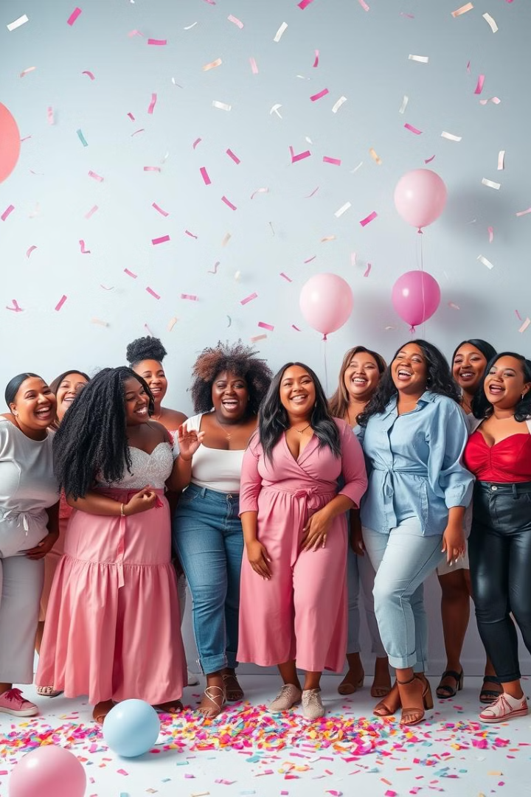
Promotion
1
Social Media Campaigns
Targeted advertising on Facebook and Instagram, engaging content for the plus-size community.
2
Website Engagement
Optimize website for user experience and easy navigation, implement SEO strategies to increase organic traffic.
3
Influencer Partnerships
Partner with plus-size influencers to expand reach, use UGC to enhance authenticity and engagement.
4
Well-Trained Moderators
Ensure smooth communication and brand representation across social media and the website, manage customer interactions, answer questions, and ensure positive engagement on all platforms.

Slide 14
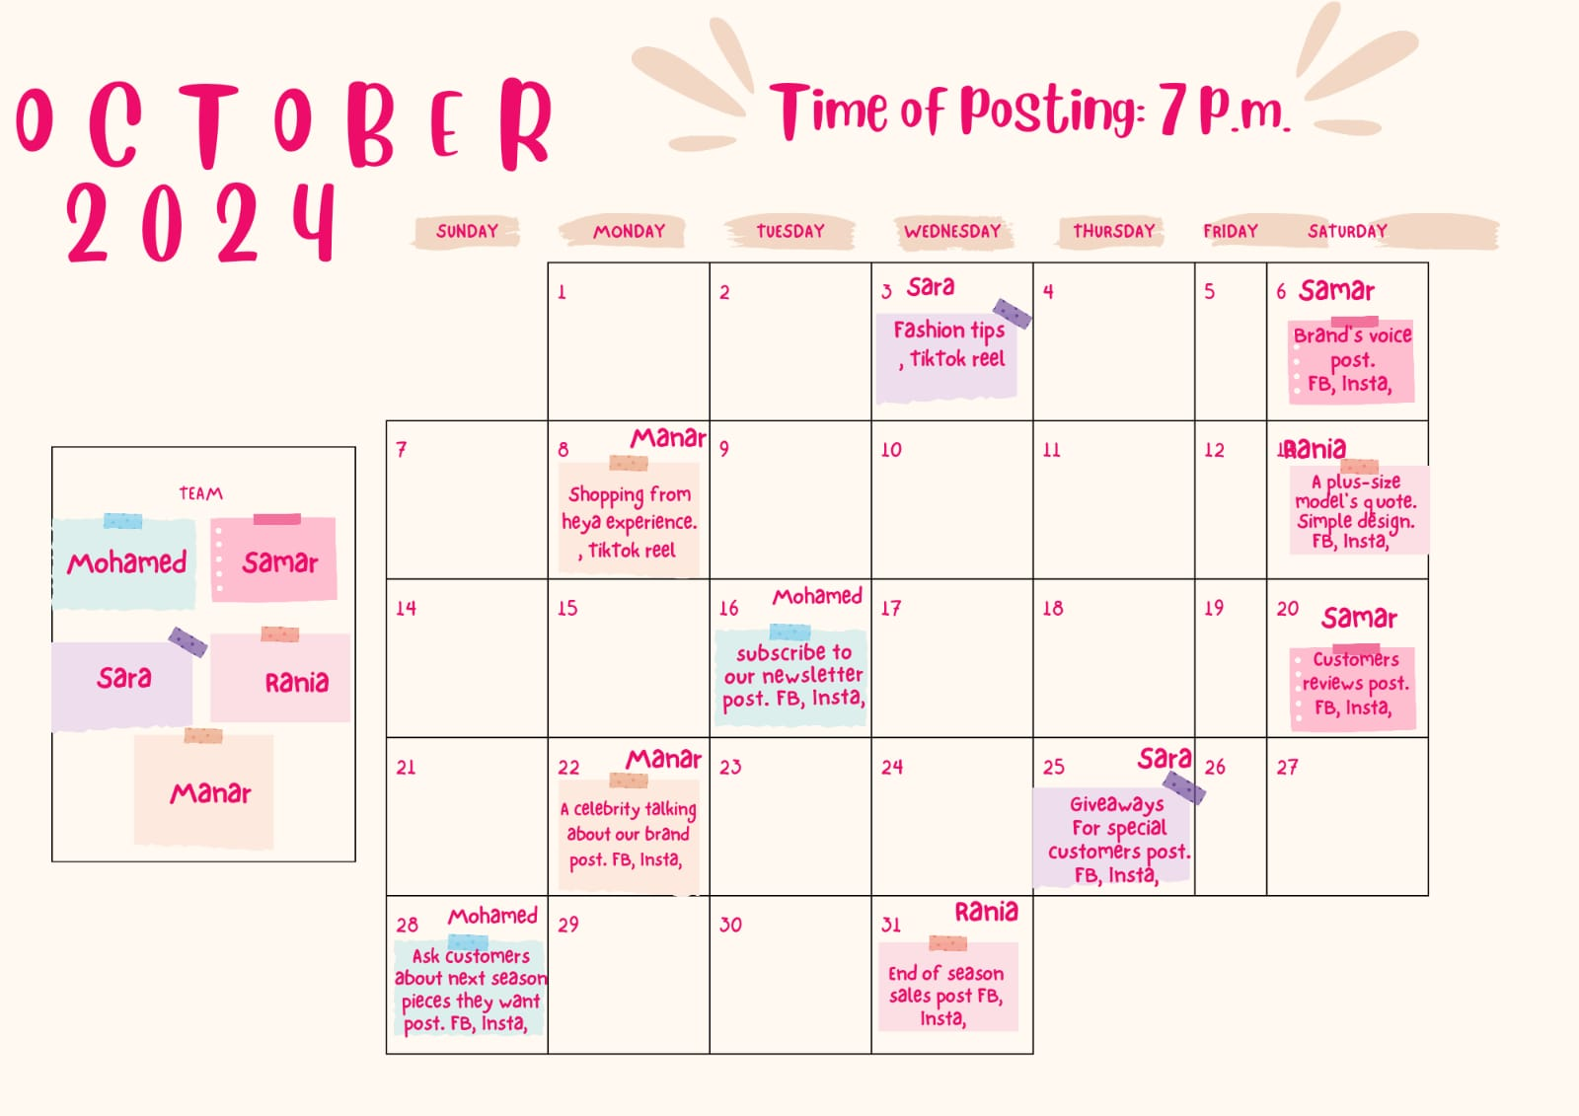
Content Calendar
Date
Platform
Content Idea
Creator
October 8
Facebook & Instagram
Style Tips for Different Body Shapes
Sara
October 10
Instagram
Outfit of the Week
Rania
October 12
Instagram
Body Positivity Quotes
Samar
October 14
Facebook & Instagram
Limited-Time Offer or Discount
Mohamed
October 16
Facebook & Instagram
New Arrival Teasers
Manar

Slide 15
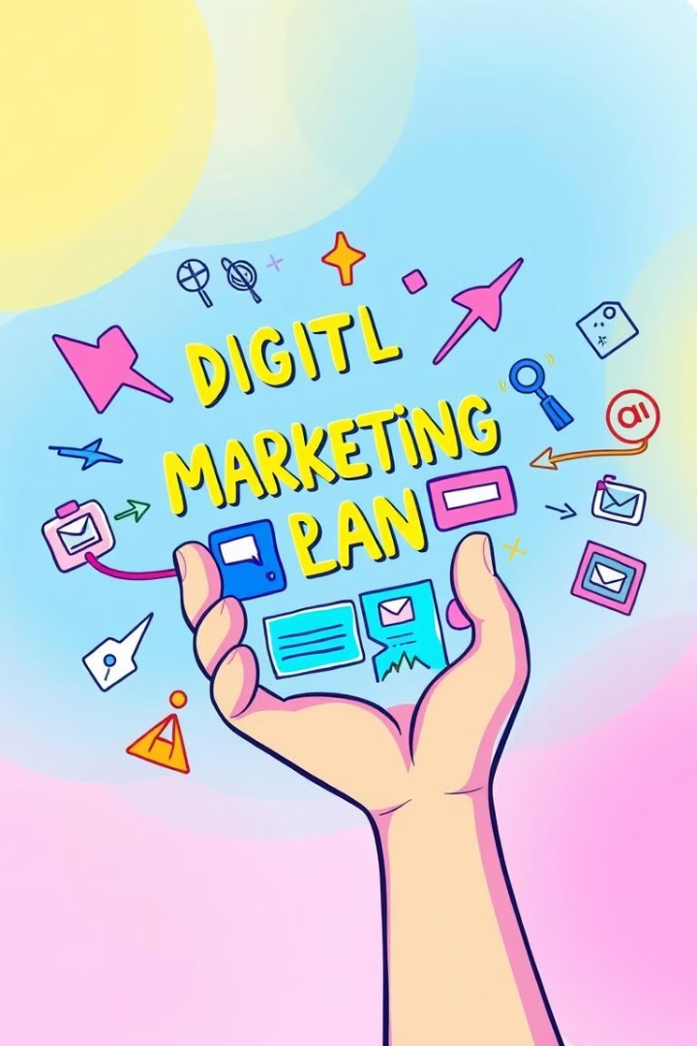
Action Plan
Website creation
Social Media Campaigns
Paid Advertising
Customer service and moderation

Slide 16
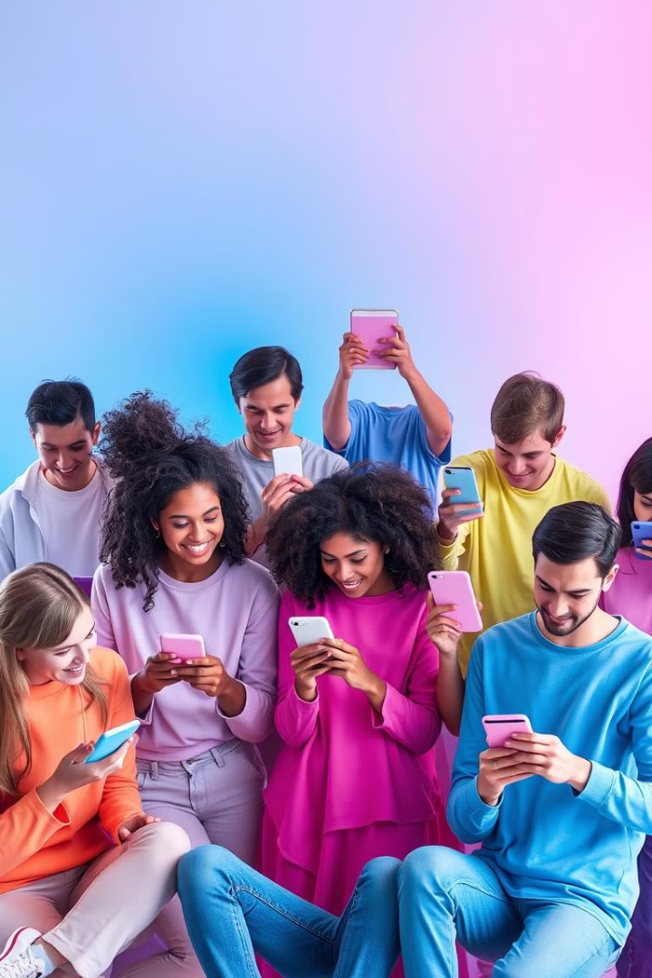
Brand Awareness
Start date: October 1st
Minimum Cost: 15,000EGP
Action 1:
Action 2:
Action 3:
Launch Campaign
Run brand awareness campaigns on Facebook and Instagram.
Influencer Collaboration
Partner with influencers in the Plus Size Fashion industry.
Share Brand Stories
Showcase brand stories and testimonials across social media.

Slide 17
2. Growth Social Media &Engagement
Start date: Beginning of the new year
Minimum Cost: 10,000 EGP Monthly
Action 1: Action 2: Action 3:
Consistent Content
Interactive Features
Community Building
Post engaging content 3-5 times per week.
Run giveaways, polls, and live videos to encourage engagement.
Respond to comments and messages promptly to foster community.

Slide 18
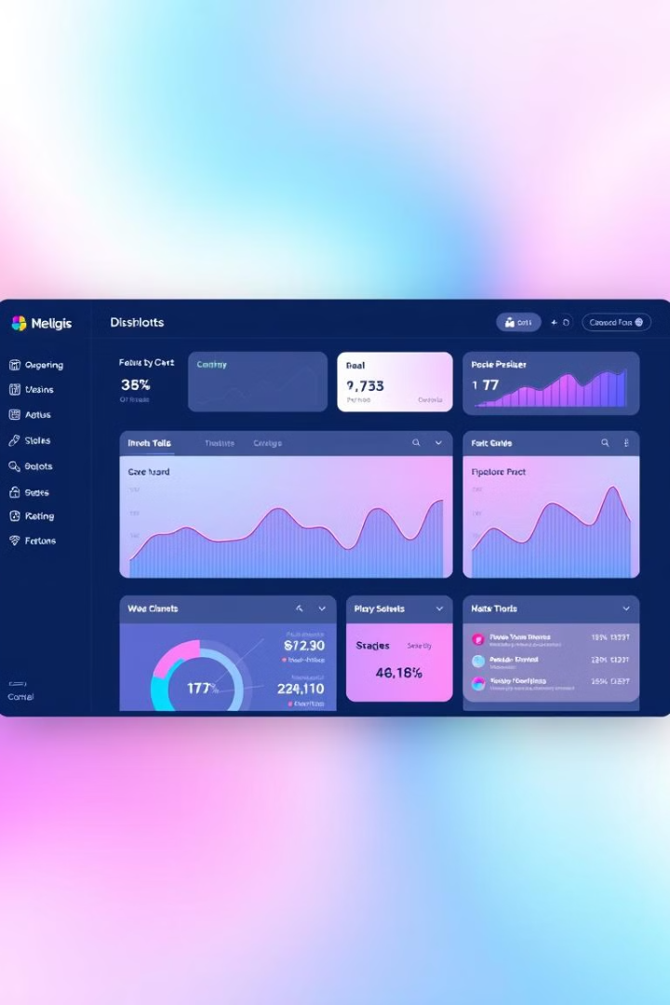
3. Website Traffic
Start date: October 15th
Minimum Cost: 4,000 EGP
Action 1:
Action 2:
Action 3:
Website Development
SEO Optimization & Google Ads
Implement best practices to improve organic search visibility.
Informative Content
Publish regular blog posts that provide value to visitors.

Slide 19
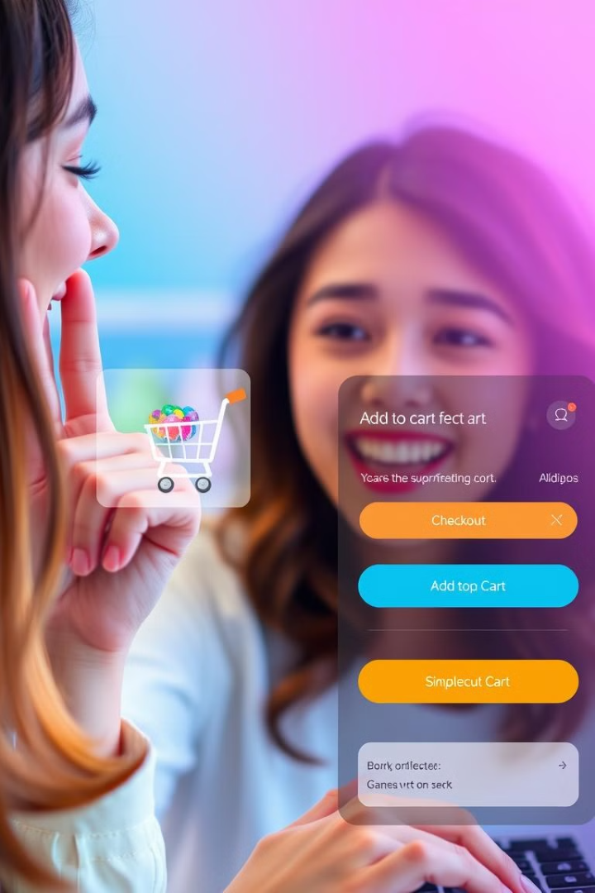
4. Conversion Rate
Start date: On February
Minimum Cost: 5,000EGP
Optimize Landing Pages
Improve user experience and calls to action on landing pages.
A/B Testing
Test different elements on the website and social media.
Retargeting Ads
Use retargeting ads to re-engage potential customers.

Slide 20
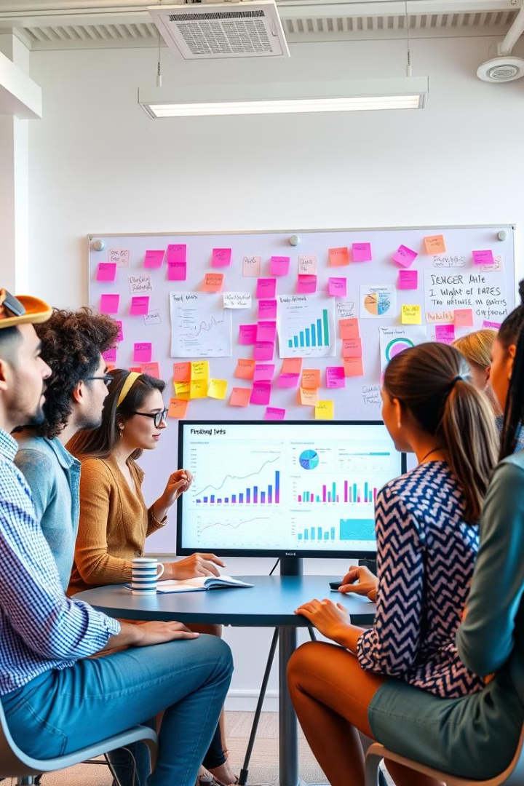



Customer Service
An exceptional customer service friendly experience through phone and through social media platforms
7000 EGP a month
Key Activities
Educated moderators effectively engage with diverse customer audiences.
Engaging with customers through social media platforms through comments , messaging and reacting .
Serving customers with after sales service .
solving customer issues such as returns .

Slide 21
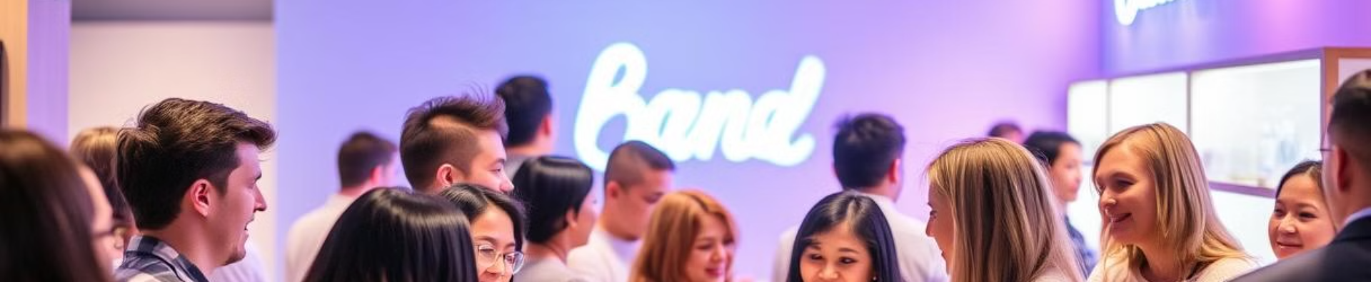



Customer Retention
Loyalty Program
Customer Feedback
Post-Purchase Engagement
Implement a program that rewards repeat purchases.
Collect feedback to improve the customer experience.
Follow up with customers after purchases to keep them engaged.

Slide 22
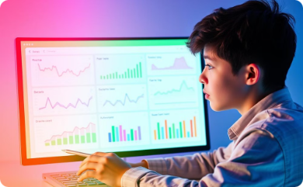
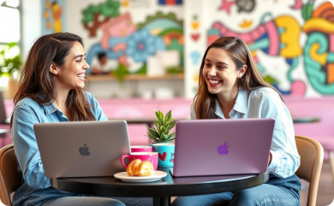
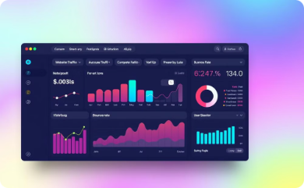
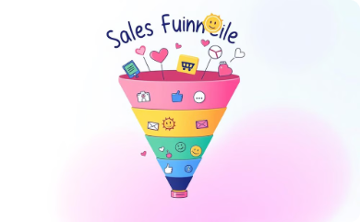
Key Performance Indicators (KPIs)
Brand Awareness
Social Media Growth & Engagement
Website Traffic
Conversation Rate
Analyze brand recognition, impressions, reach, and media mentions. Track search volume and understand customer sentiment.
Track total website visits, unique visitors, bounce rate, and traffic sources to identify areas for improvement.
Evaluate the effectiveness of marketing efforts. Track conversion rate, click-through rate, cost per conversion, cart abandonment rate, and revenue growth.
Measure engagement rate, post reach, new followers, audience demographics, and follower engagement rate.

Slide 23
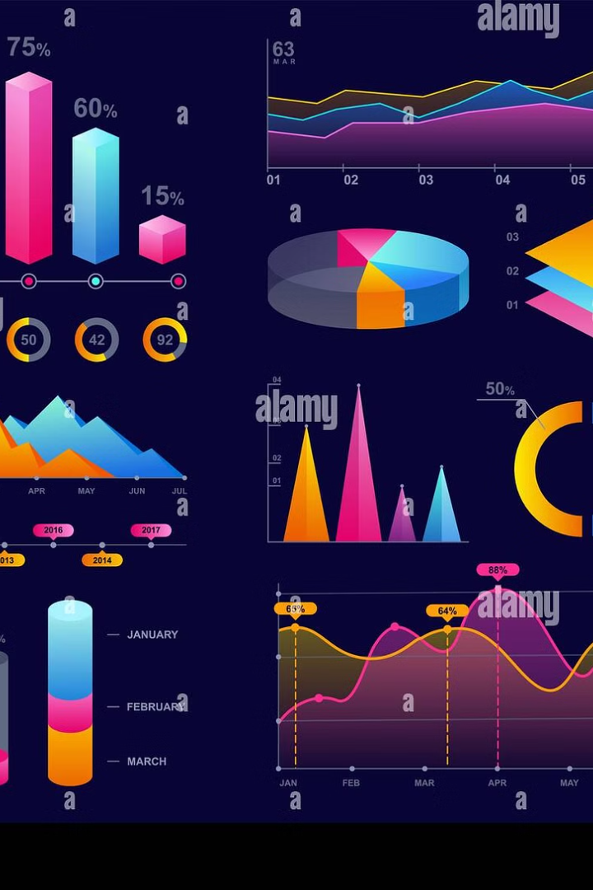
Control, Insights and Improvements|
Facebook engagement analysis reveals low interaction despite strong impressions.
Most posts had very low minutes viewed

Slide 24

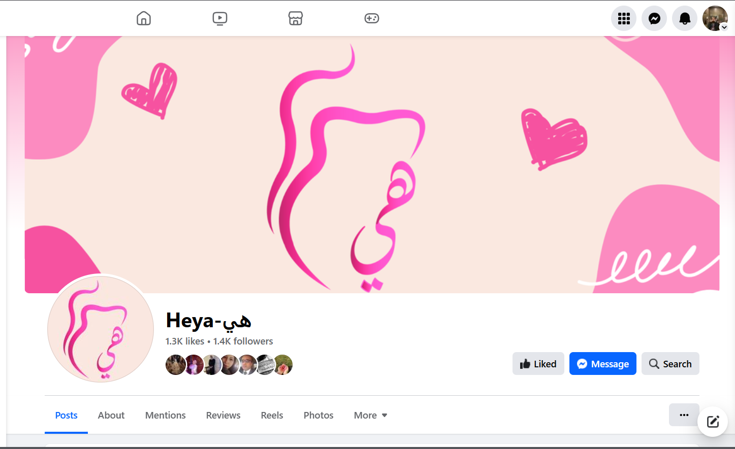

Slide 25
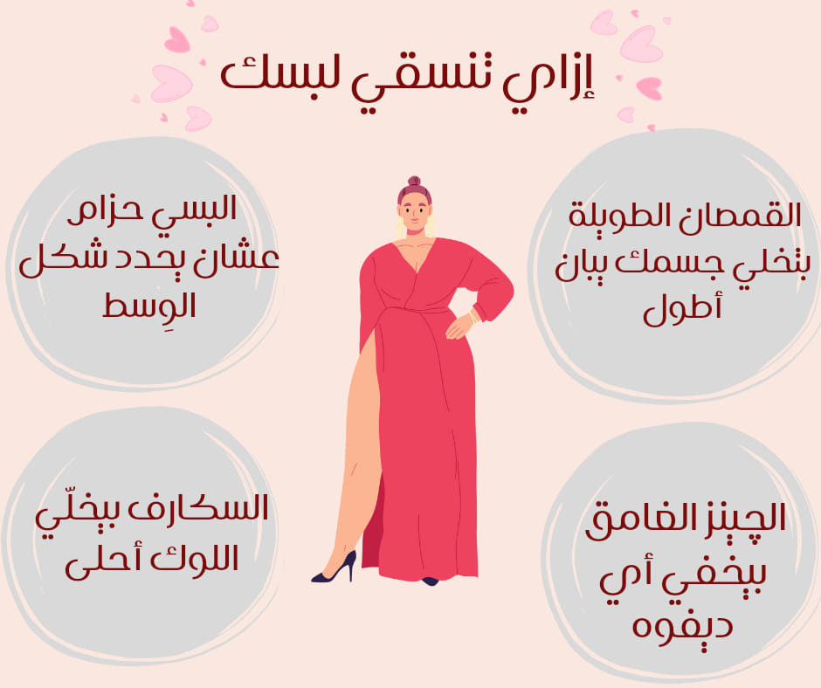

Slide 26
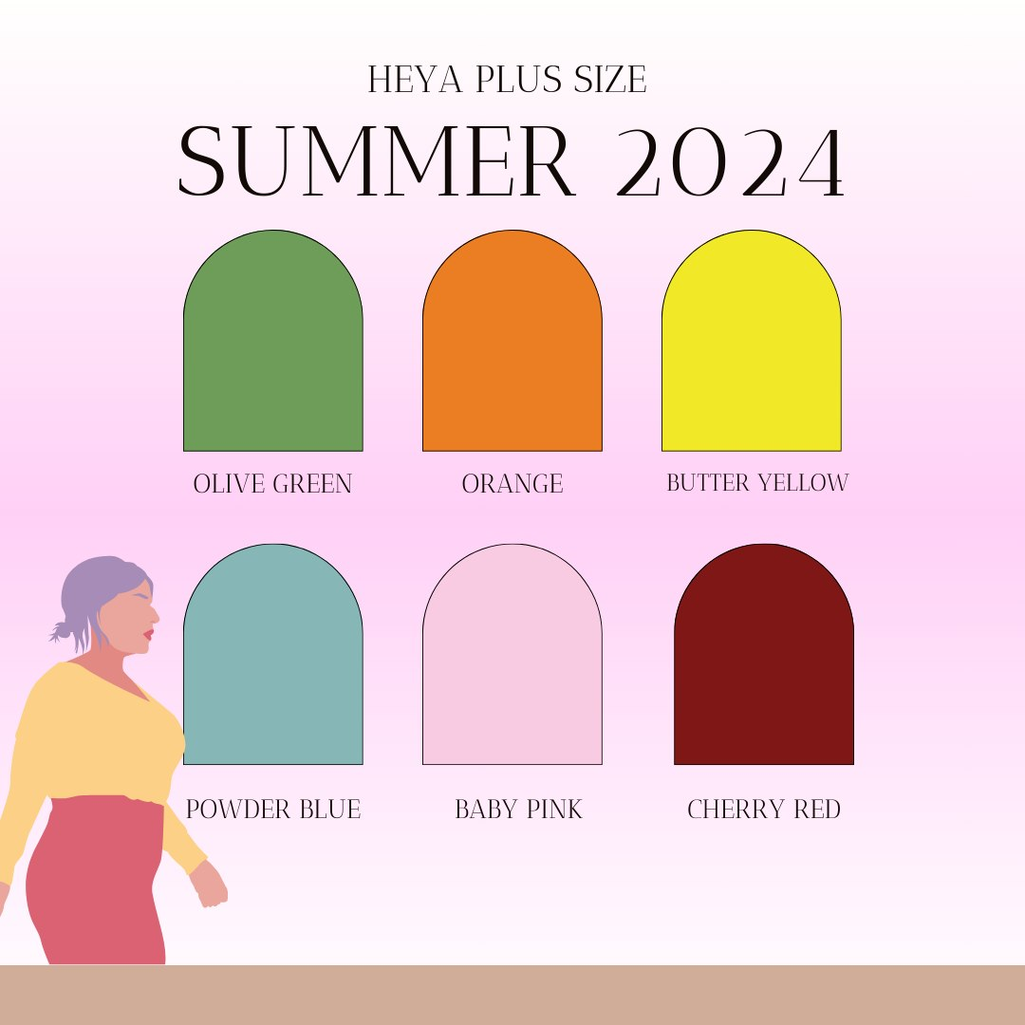

Slide 27
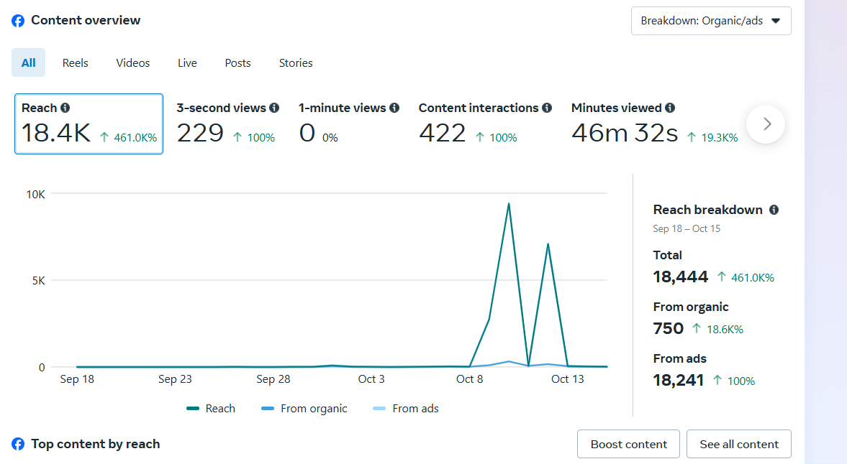

Slide 28
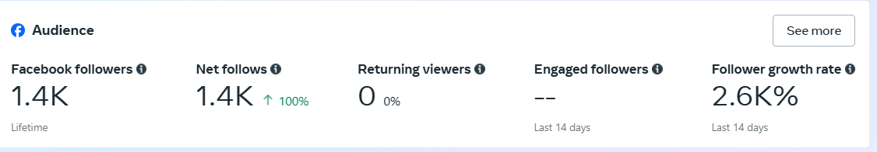
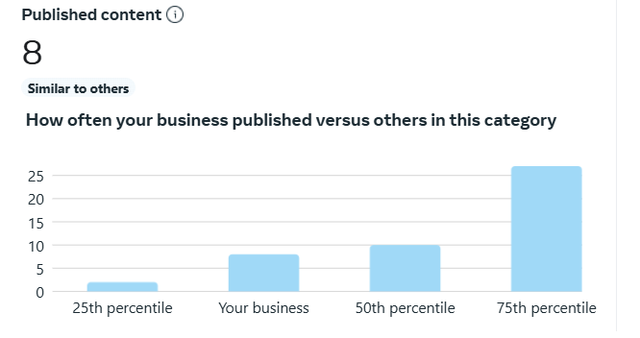

Slide 29
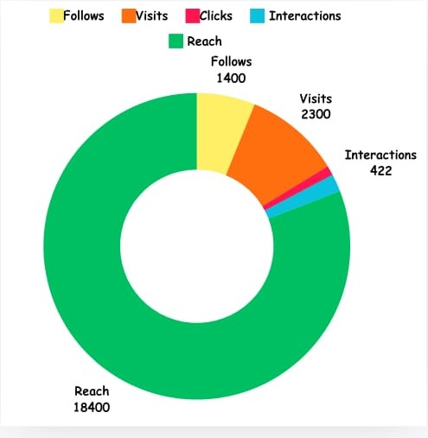
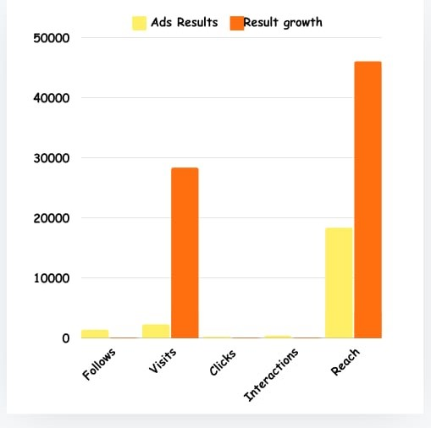

Slide 30
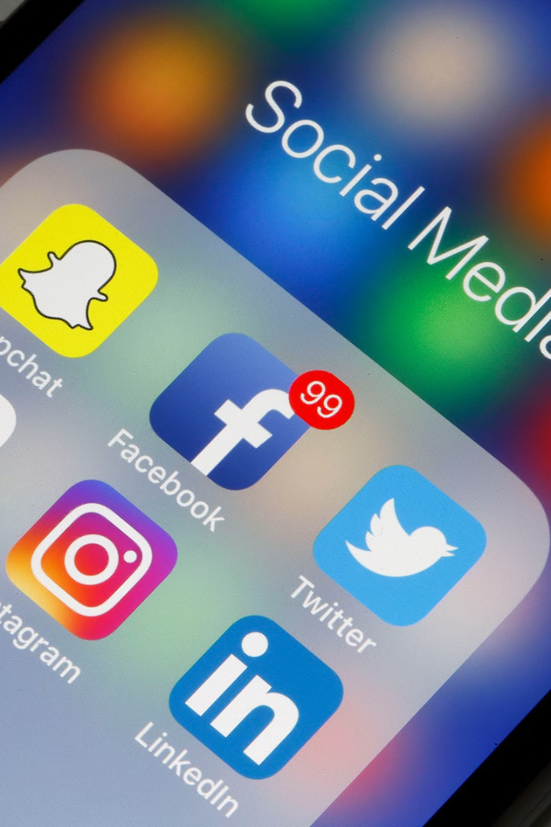
Increase Publication Frequency
1
Current Frequency
Our current publication frequency is below the industry median.
2
Increase Frequency
Increase publication frequency to match or exceed industry standards.
3
Monitor Impact
Track engagement metrics to assess the impact of increased frequency.

Slide 31

Target Audience Content
1
Targeted Audience
2
Content Focus
3
Engagement Strategy
Our Facebook ads target women aged 25 to 44.
Create content tailored to the interests and needs of this demographic.
Develop engaging content that resonates with this target audience.

Slide 32
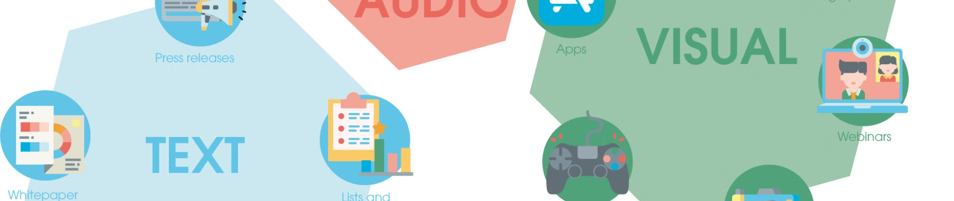
Experiment with Visual Formats
Carousel Format
Video and Reels
High-Quality Visuals
Experiment with carousel photo formats to enhance visual appeal.
Focus on creating engaging videos and reels to capture audience interest.
Use high-quality images and videos to enhance visual appeal.

Slide 33




Engagement Strategies
Clear CTAs
A/B Testing
Influencer Collaboration
Include clear CTAs in posts to invite followers to engage.
Consider A/B testing different types of posts to see what resonates better with the audience.
Collaborate with influencers to extend reach and engagement.

Slide 34
Content Enhancement
Creative Design
Increased Advertising
Retargeting Campaigns
Enhance content with a creative designer for better engagement.
Increase advertising budget to expand reach.
Implement retargeting campaigns to re-engage previous viewers.

Slide 35
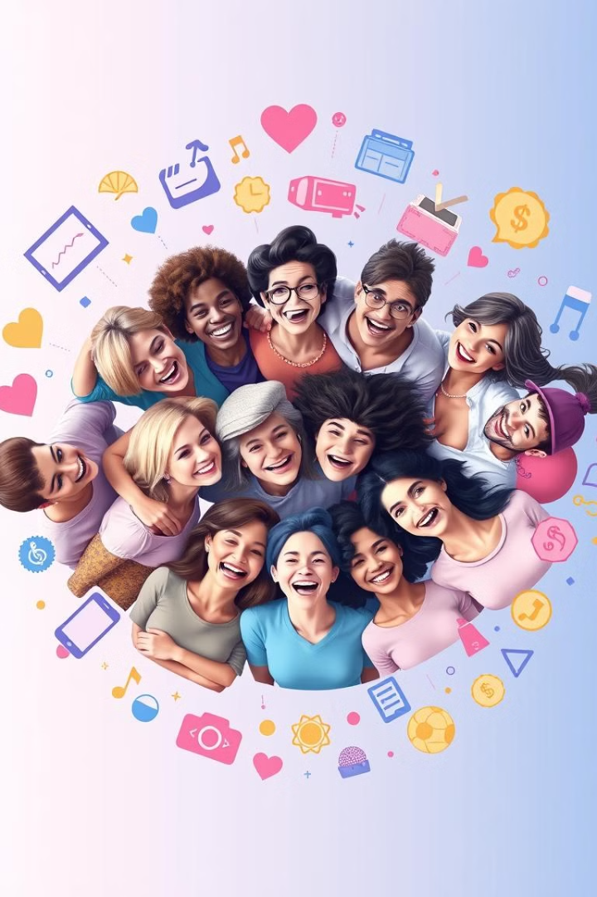
Audience Insights
Use Facebook's audience insights to identify segments that responded well to the ads.
Tailor content to the interests of these segments.

Slide 36





Cross-Promotion
Facebook Stories
Publish stories on both Facebook and Instagram.
Instagram Stories
Publish stories on both Facebook and Instagram.
User-Generated Content
Encourage user-generated content to increase engagement.
Feature Reviews
Feature reviews and testimonials to build trust and credibility.

Slide 37
Customer Service
An exceptional customer service friendly experience through phone and through social media platforms
7000 EGP a month
Key Activities
Educated moderators effectively engage with diverse customer audiences.
Engaging with customers through social media platforms through comments , messaging and reacting .
Serving customers with after sales service .
solving customer issues such as returns .

Slide 38

Any Questions?
Open to questions and discussion.

